Slide 1


FOX NUT PROJECT

Slide 2


FOX NUT
Fox Nut also known as “Makhana”
HS Code - 19041090
Fox Nut is the Seed of the lotus plant “ Euryale Fox”
These Seeds are often dried and roasted
Fox Nut are known for their Nutrituional Benefit
They are low in Calories and high in Protein, Fiber and Antioxidants
Some of their key Benefits of FOX NUT
Weight Management, Hearth Management, Improved Digestion, Bone Health, Skin and Hair Health, Blood Sugar Control etc…

Slide 3

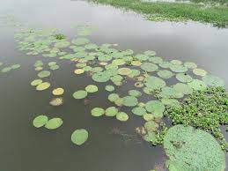
FOX NUT FARMING IN INDIA & INTERNATIONAL
Bihar is the leading State in the Production of Makhana with 90% Production in the world
Districts like Darbhanga, Madhubani, and Surrounding Areas, is known for its large scale cultivation of Makhana
Other State like West Bengal, Assam and Parts of Eastern Uttar Pradesh contributing in smaller quantities
Beside India, China is the second largest Producer of Makhana
Makhana is traditionally cultivated I regions like “ Hunan and Jiangxi “ in China

Slide 4
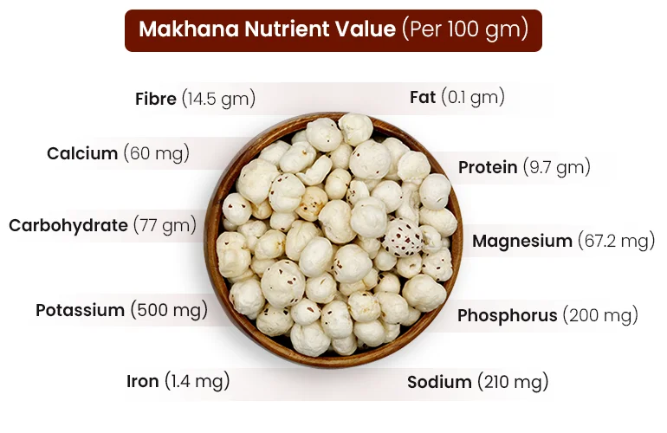
NUTRITIONAL VALUE OF FOX NUTS (MAKHANA) PER 100G

Slide 5
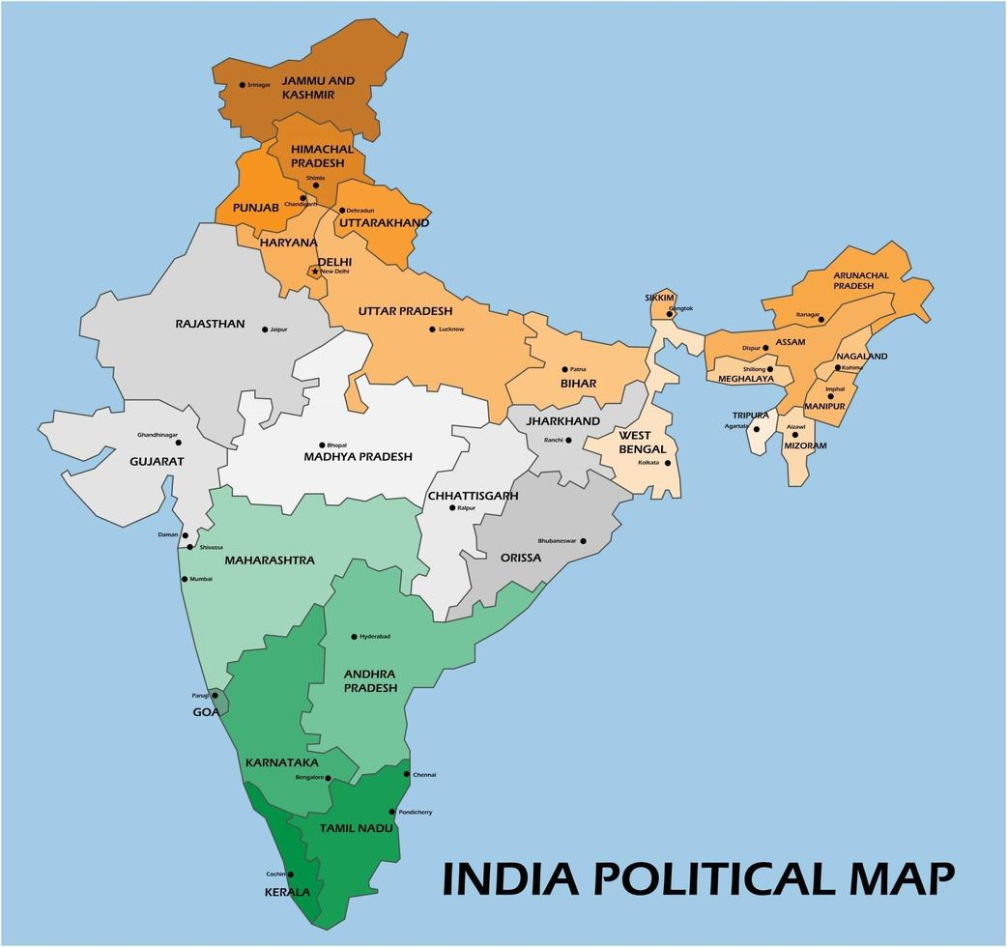
List of Indian States where Makhana Production Place
BIHAR
UTTAR PRADESH
WEST BENGAL
MADHYA PRADESH
ASSAM
MANIPUR
JHARKHAND
TRIPURA
CHHATTISGARH

Slide 6
PRODUCTION OF MAKHANA IN INDIA
India is the world's biggest producer, contributing between 70 and 80% of the total production. More than 80% of India's Makhana is produced in Bihar. In addition, Makhana is grown in its wild form in Russia, Bangladesh, China, Japan, Korea, and other nations.
State | Area Under Cultivation (Ha) | Production (MT)
Bihar | 12,000 | 96,000
Jharkhand | 1,000 | 8,000
Uttar Pradesh | 500 | 4,000
Other States | 500 | 4,000
Total | 15,000 | 120,000

Slide 7
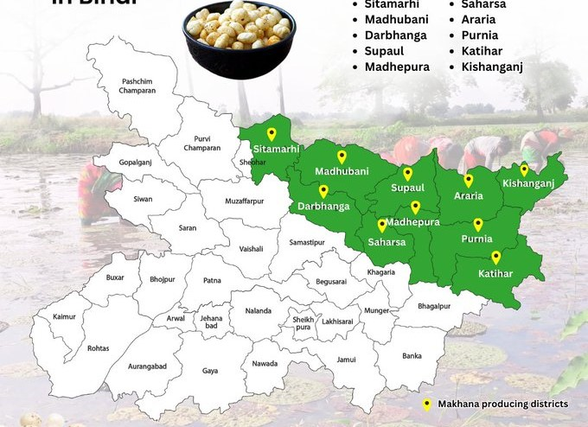
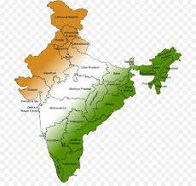
MANUFACTURERS IN INDIA
Bihar is the hub of Makhana production
Manju Makhana ( Darbhanga, Bihar )
Vaidehi Foods ( Bihar )
Makhana King ( Bihar )
Makhana Amrit ( Darbhanga, Bihar )
Bihar Makhana ( Bihar )
Some Manufacturers and Regions where Makhana is Produced beside Bihar
Sattviko ( Delhi )
Shakti Shudha ( M.P )
Kanha Foods ( Kanpur, U.P )
Phool Makhana ( U.P )
K.K Products ( West Bengal )

Slide 8
EXPORT FROM INDIA
Makhana exports | Makhana export data from India (value)
Total Makhana Shipments (Tonnes) | 25,130
Number of Makhana Exporters | 1,123
Number of Makhana Buyers | 2,969
TOP 3 NATIONS THAT EXPORT MAKHANA OVERSEAS
India at first with 25,130 shipments
China at second with 238 shipments
Pakistan at third with 70 shipments.

Slide 9
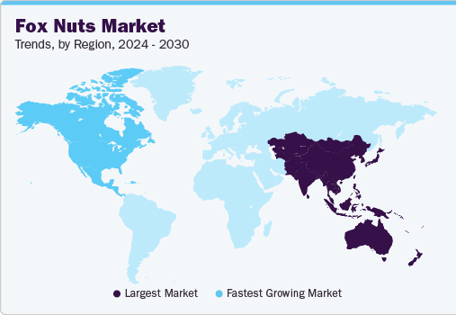
Importing Country of Fox Nut from India
United States
United Kingdom
CANADA
AUSTRALIA
United Arab Emirates
Southeast Asia
European Union
GERMANY
FRANCE
SINGAPORE
SOUTH KOREA

Slide 10

DOCUMENTS REQUIRED FOR CONTAINER EXPORT
Commercial Invoice
A detailed bill outlining the goods being shipped, their quantities, value, and agreed terms.
It is used for customs purposes to determine duties and taxes.
Packing List
Lists the contents of each package, including the type, quantity, and weight of items.
Helps with customs inspections and warehouse management.
Bill of Lading (BOL) or Airway Bill
Serves as a receipt from the carrier to the exporter.
Specifies the type of goods, destination, and shipping details.
Acts as a title of ownership and is required for the release of goods at the destination.

Slide 11
Certificate of Origin
Certifies the country in which the goods were manufactured.
Some countries require this to apply preferential tariffs or determine import restrictions.
Export License (if applicable)
Required for certain goods or destinations, especially if exporting regulated items (e.g., pharmaceuticals, electronics).
Shipper’s Letter of Instruction (SLI)
Provides detailed instructions to the freight forwarder, including special handling or routing.
Used to communicate specific terms with the carrier or freight forwarder.

Slide 12
Inspection Certificate (if applicable)
Verifies that the goods meet quality and safety standards.
Often required for products like food, chemicals, and electronics.
Insurance Certificate
Proof that the goods are insured during transit.
Provides coverage details, including the type and extent of coverage.
Letter of Credit (if applicable)
A document from the buyer’s bank guaranteeing payment once specific conditions are met.
Used to secure payment for goods in international trade.
Customs Declaration (for Export)
A document required by customs authorities for export, detailing the goods and their value.
This can be filed electronically in many countries.

Slide 13

FOX NUT BUYERS
FRUITICANA PRODUCE LIMITED (CANADA)
COSMO FOOD SERVICE (ITALY)
NORTH ZONE (DUBAI-UAE)
INDYA FOODS PTY LTD (AUSTRALIA)
Sourcing :- Google

